Slide 1
Unnat Bharat Abhiyan

Slide 2
Unnat Bharat Abhiyan
ST. XAVIER’S COLLEGE FOR WOMEN ALUVA
REPORT OF THE ACTIVITIES
2019-20

Slide 3
About UBA
Unnat Bharat Abhiyan is inspired by the vision of transformational change in rural development processes by leveraging knowledge institutions to help build the architecture of an Inclusive India.

Slide 4
Unnat Bharat Abhiyan
The whole idea of Unnat Bharat Abhiyan is that
The educational institutions in the country help in overall nation development by adopting villages.
The educational institutions understand and participate in the development process by employing technologies in the rural areas and in turn students of the academic institutions and faculty members will enrich themselves.
All-in-all, Unnat Bharat Abhiyan aims to create a vibrant relationship between the society and the higher educational institutions, with the latter providing the knowledge and technology support to improve livelihoods in rural areas and to upgrade the capabilities of both the public and private organizations in the society.

Slide 5
UBA 2.0
Our institution became a part of Unnat Bharat Abhiyan 2.0 in October 2018
Conducted surveys and awareness programmes on government schemes for villages
Used Single window platform http://unnatbharatabhiyan.gov.in/ for entering the data collected.
Social platforms like Facebook and instagram to highlight field experiences.
2 faculty members attended Regional workshop for Participating Institutions
Our institution is now a UBA Participating Institute
Received a fund of fifty thousand (Rs.50000/-) for conducting different awareness programmes

Slide 6
Adopted Villages of St. Xavier’s College for Women
Malayattoor
Kalady
Kadungalloor
Karumalloor
Chendamangalam

Slide 7
Activities @ Malyattoor Panchayat
Survey & Awareness Session at Grama Sabha

Slide 8
Activities @ Malyattoor Panchayat
Household Surveys

Slide 9
Activities @ Malyattoor Panchayat
Survey & Awareness Session at Grama Sabha

Slide 10
Activities @ Chendamangalam Panchayat
Household Surveys

Slide 11
Activities @ Chendamangalam Panchayat
Household Surveys

Slide 12
Activities @ Kalady Panchayat

Slide 13
Activities @ Kalady Panchayat
Household Surveys

Slide 14
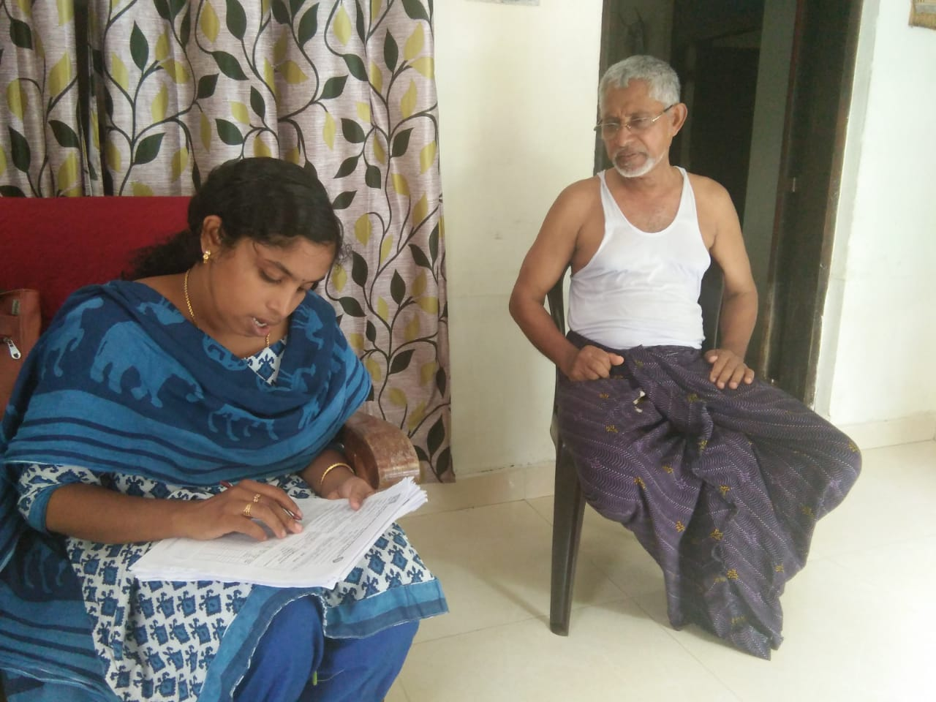
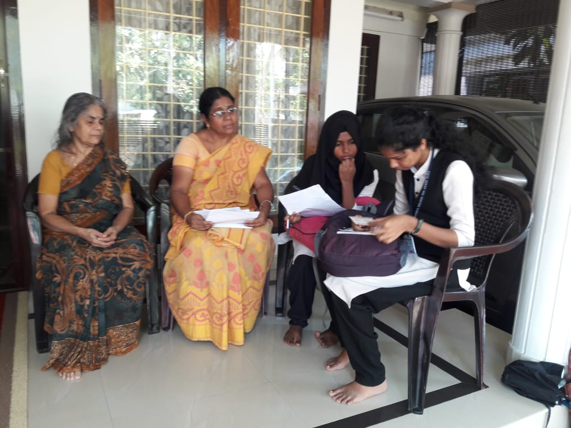
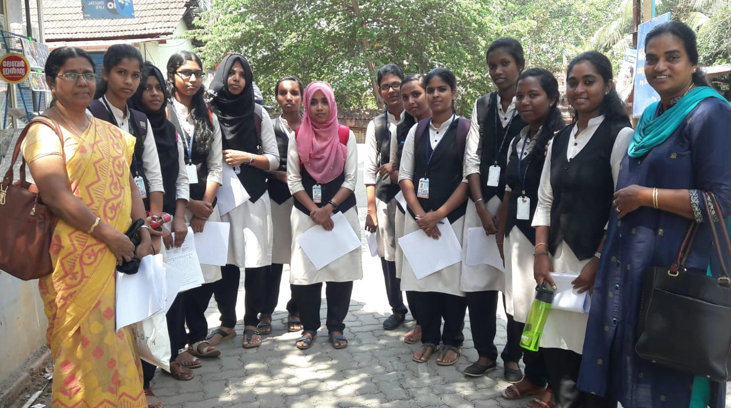
Activities @ kadungalloor Panchayat

Slide 15
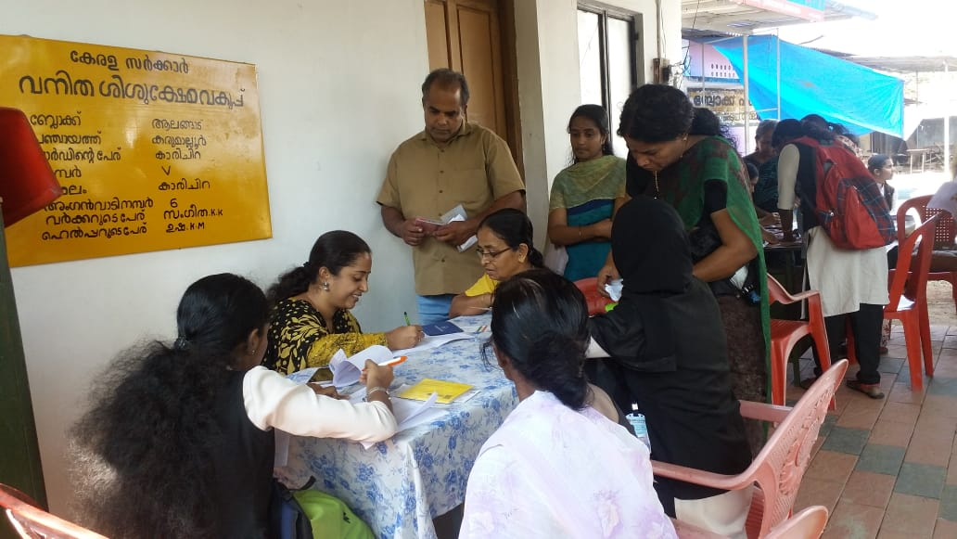
Activities @ Karumalloor Panchayat

